Slide 1

Peak Pricing: Elevating Revenue at Big Mountain Resort

Slide 2
Current Evaluation
Big Mountain Resort:
Charges $81 for an adult weekend ticket
Has 105 runs
600 acres of snow making area
3 Fast quads
Vertical Drop if 2353 ft
Notes:
Big Mountain Resort boasts an impressive array of premier amenities, encompassing 105 runs, a sprawling 600 acres of snowmaking terrain, 3 state-of-the-art fast quad lifts, and a remarkable vertical drop of 2553 feet. Despite offering these exceptional facilities, the resort currently prices its adult weekend tickets at $81. Given the extensive amenities available, is there an opportunity for Big Mountain to strategically adjust its ticket prices or implement cost-saving measures to enhance overall revenue?

Slide 3
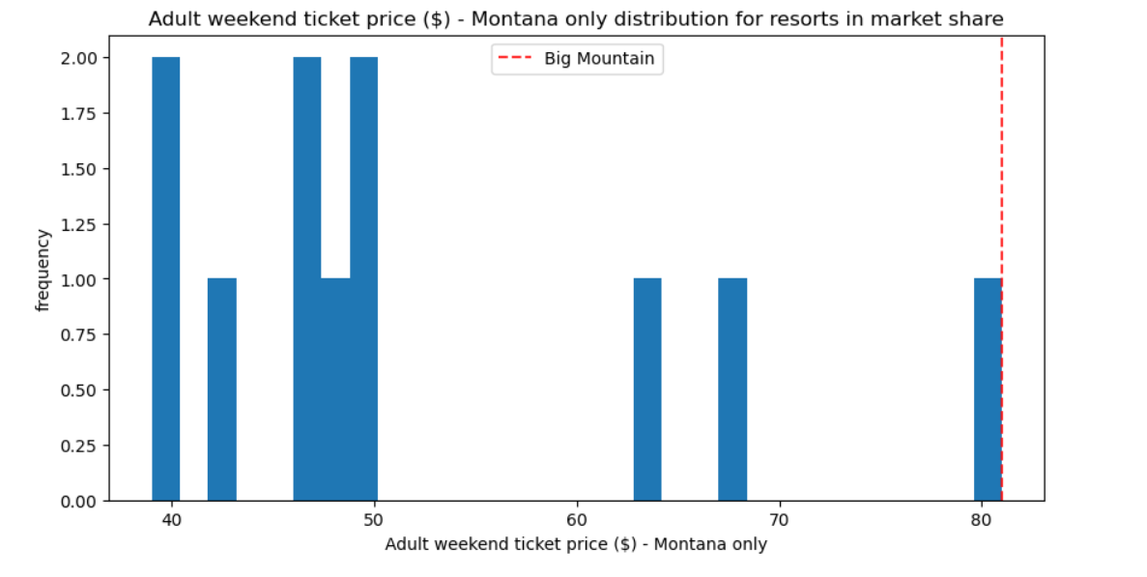
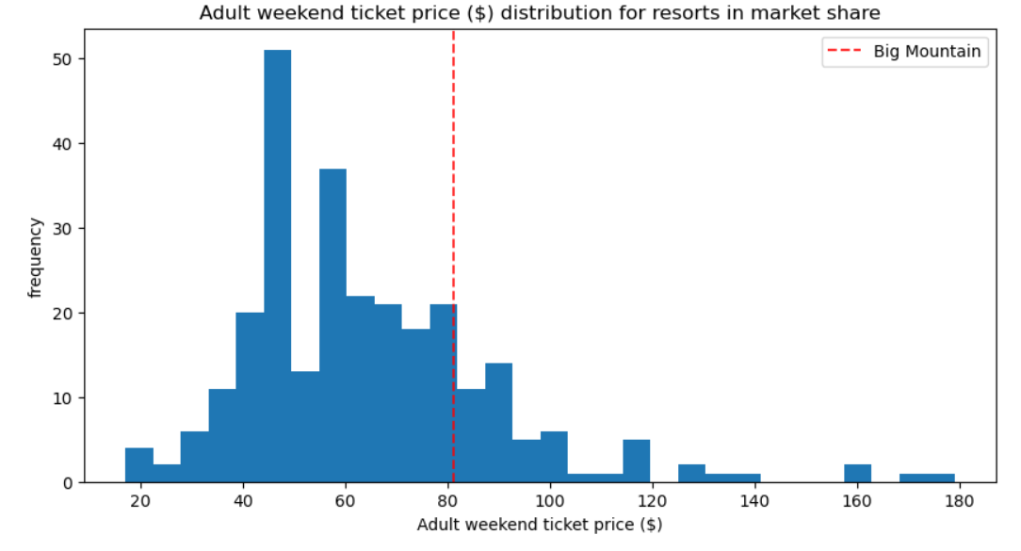
Adult Ticket Price Comparison
Big Mountain Resort charges the highest prices among Montana resorts
Big Mountain Resort has greater potential for growth compared to resorts across the country.
Notes:
Where does Big Mountain Resort stand in pricing compared to other resorts in the state? How about the country? While Big Mountain Resort may seem to be at the pinnacle of pricing within Montana, a broader comparison reveals opportunities for further adjustment. The cost of a resort ticket may not be solely determined by location. During our analysis, we examined which resort features justify pricing adjustments, indicating potential for optimization beyond local market constraints.

Slide 4
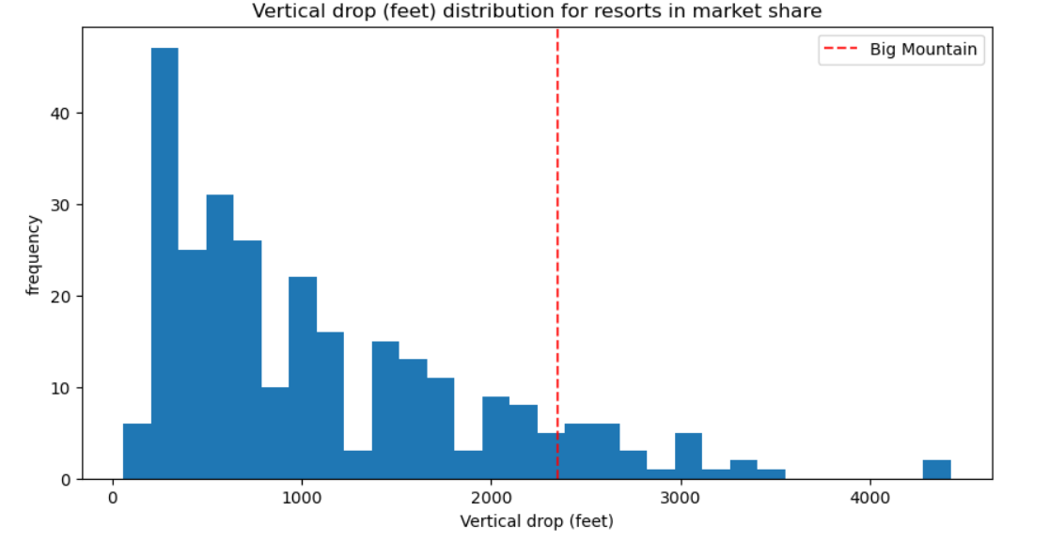
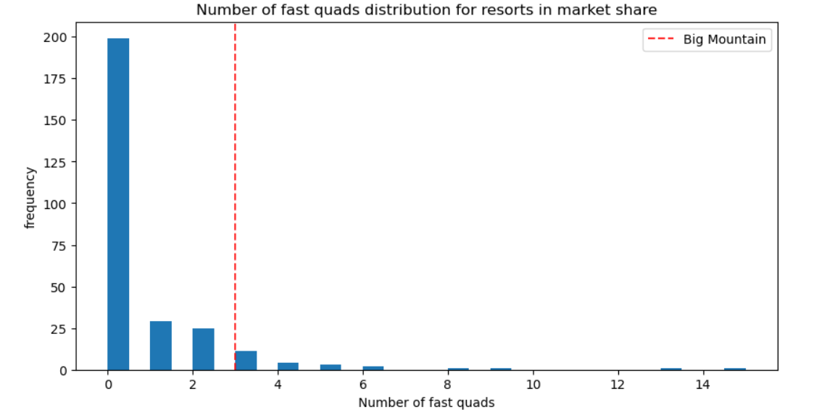
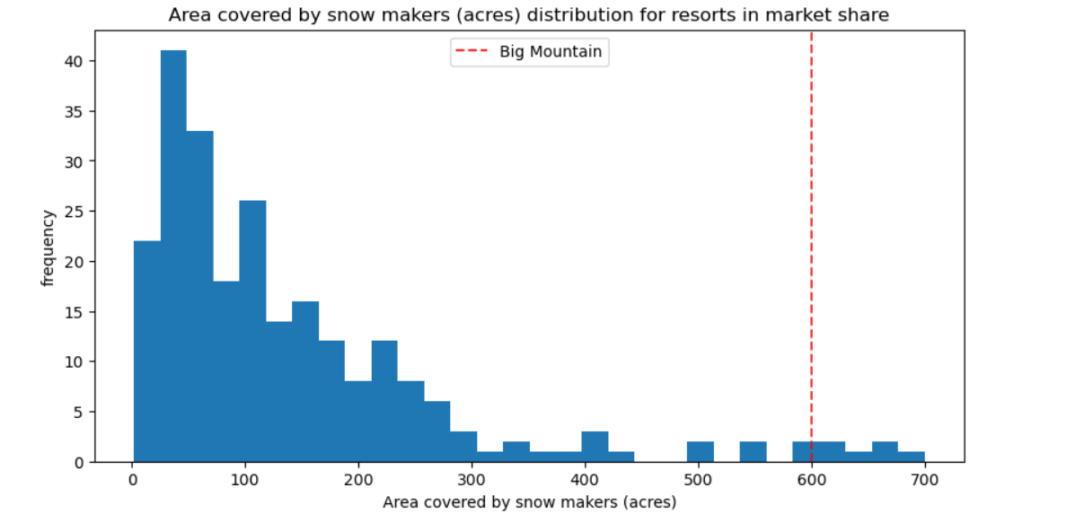
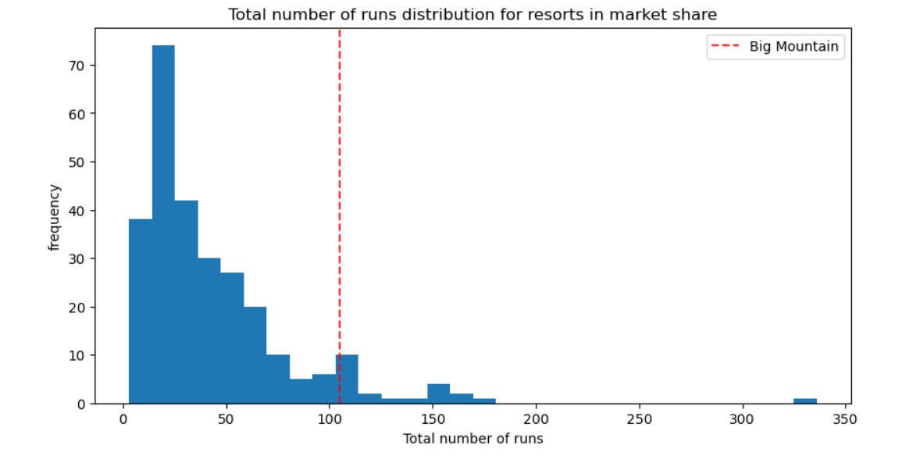
Rankings Across country for these topics
Notes:
Our findings indicate that Big Mountain Resort ranks favorably in terms of amenities that guests are willing to pay a premium for. This insight suggests the potential for a price increase based on the resort's outstanding features and offerings.
Based on these features, our model suggests that Big Mountain Resort’s modelled price is $95.87 with the expected mean absolute error of $10.39. This suggests there is room for increase.

Slide 5
Optimizing Ticket Prices
Big Mountain adds a run, increases vertical drop by 150ft, and install additional chair lift
Increases support for ticket price by $1.99
Potential revenue over the season of $3,474,638
Notes:
Conducting a cost analysis across three scenarios aimed at either reducing costs or enhancing revenue, Scenario 2 emerges as the most favorable for Big Mountain Resort. By incorporating an additional run, increasing the vertical drop by 150 feet, and installing an extra chairlift, our projections indicate the potential to raise ticket prices by $1.99 per ticket. This adjustment could result in a substantial annual revenue increase of $3,474,638.

Slide 6
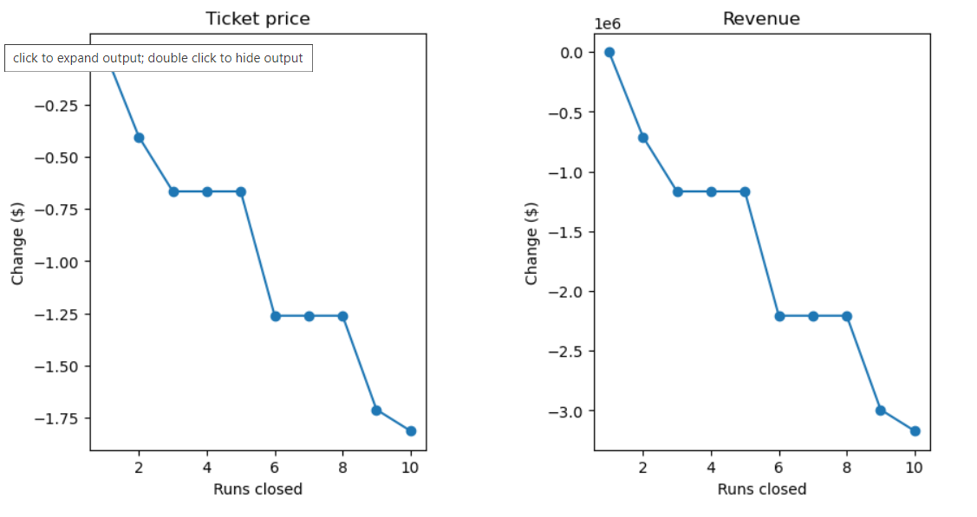
Cost of Shutting Down Runs
Shutting down 1 run
no change
Shutting down multiple runs
significant loss 2-3 runs
no change between 3-5
Notes:
Furthermore, our analysis suggests that Big Mountain Resort can experiment with closing certain runs without significant revenue loss. Closing one run demonstrates negligible impact, while closing two runs incurs a marginal decrease of approximately 0.50 per ticket. However, the closure of three to five runs lead to more substantial revenue declines, with no discernible difference in price impact until the closure of six runs. Therefore, if considering run closures, it may be advantageous to evaluate the cost-benefit of closing multiple runs simultaneously.

Slide 7
Summary
There is justification through our modeling that Big mountain resort is under charging for their ticket prices and can be increased to align with their amenities offered.
Adding a run, increasing vertical drop by 150ft, and installing an additional chair lift can justify another $1.99 increase in ticket prices
Shutting down 1 run will have no impact, but 2 or more will negatively affect revenue
Notes:
Currently, Big Mountain Resort offers an Adult Weekend Ticket at 81.00 dollars, which our analysis indicates is below the optimal price. Considering the breadth of amenities available at Big Mountain, our model suggests that a ticket price of 95.87 dollars is more aligned with market expectations, with an expected margin of error of 10.39 dollars. This suggests there is indeed room for a price adjustment.
In addition, by optimizing on preferred amenities, there is evidence to increase tickets sales by another $1.99
When examining reduction in costs, shutting down 1 run may decrease costs when including cost of maintenance and upkeep, while shutting down 2 or more may negatively affect revenue

